Slide 1


BITS Pilani
Pilani Campus
Session 6
These slides are prepared by the instructor, with grateful acknowledgement of many others who made their course materials freely available online.

Slide 2
Likelihood Based Model: Flow Models
Readings:
Simon D. Prince, Understanding Deep Learning, Chapter 16
Normalizing Flow Blog
Normalizing Flow Tutorial
https://github.com/udlbook/udlbook/tree/main/Notebooks/Chap16
BITS Pilani, Pilani Campus

Slide 3
Lecture overview
Foundations of Flows (1-D)
2-D Flows
N-D Flows
Autoregressive Flows and Inverse Autoregressive Flows
RealNVP (like) architectures
Glow, Flow++, FFJORD
Dequantization
3
BITS Pilani, Pilani ₄Campus

Slide 4

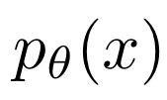
Overview
What do we want from a generative model?
Good fit to the training data (really, the underlying distribution!)
For new x, ability to evaluate
Ability to sample from
A latent representation / embedding space that’s meaningful
Recall L2 Autoregressive Models?
Check many boxes except
Sampling is serial (hence slow)
Lacks latent representation / embedding space
Limited to discrete data (at least in terms of where experimental success has been)
Flow Models will check all boxes (but performance not as good as other models…)
5
BITS Pilani, Pilani Campus

Slide 5




Our Goal Today
How to fit a density model with continuous
What do we want from this model?
Good fit to the training data (really, the underlying distribution!)
For new x, ability to evaluate
Ability to sample from
And, ideally, a latent representation that’s meaningful
Differences from Autoregressive Models from last lecture
BITS Pilani, Pilani⁸Campus

Slide 6
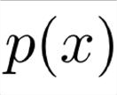
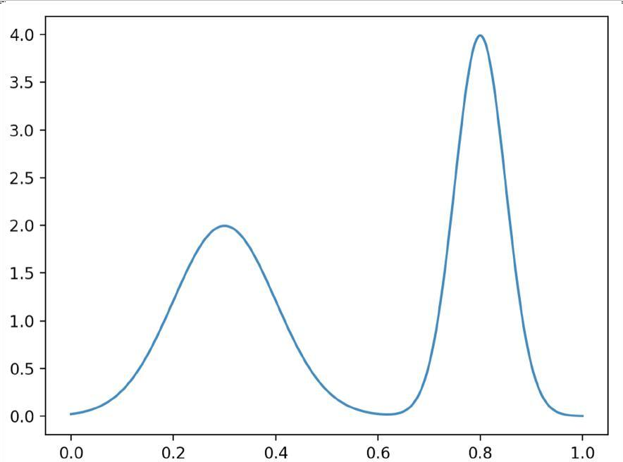
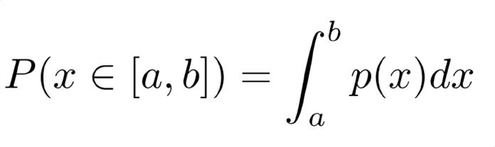

Quick Refresher: Probability Density Models
1
BITS Pilani, Pilani₀Campus

Slide 7
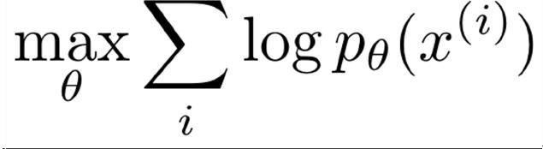
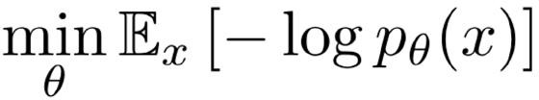
How to fit a density model?
Continuous data Maximum Likelihood:
0.22159854, | 0.84525919, | 0.09121633, | 0.364252 , | 0.30738086,
0.32240615, | 0.24371194, | 0.22400792, | 0.39181847, | 0.16407012,
0.84685229, | 0.15944969, | 0.79142357, | 0.6505366, | 0.33123603,
0.81409325, | 0.74042126, | 0.67950372, | 0.74073271, | 0.37091554,
0.83476616, | 0.38346571, | 0.33561352, | 0.74100048, | 0.32061713,
0.09172335, | 0.39037131, | 0.80496586, | 0.80301971, | 0.32048452,
0.79428266, | 0.6961708, | 0.20183965, | 0.82621227, | 0.367292 ,
0.76095756, | 0.10125199, | 0.41495427, | 0.85999877, | 0.23004346,
0.28881973, | 0.41211802, | 0.24764836, | 0.72743029, | 0.20749136,
0.29877091, | 0.75781455, | 0.29219608, | 0.79681589, | 0.86823823,
0.29936483, | 0.02948181, | 0.78528968, | 0.84015573, | 0.40391632,
0.77816356, | 0.75039186, | 0.84709016, | 0.76950307, | 0.29772759,
0.41163966, | 0.24862007, | 0.34249207, | 0.74363912, | 0.38303383, | …
Equivalently:

Slide 8
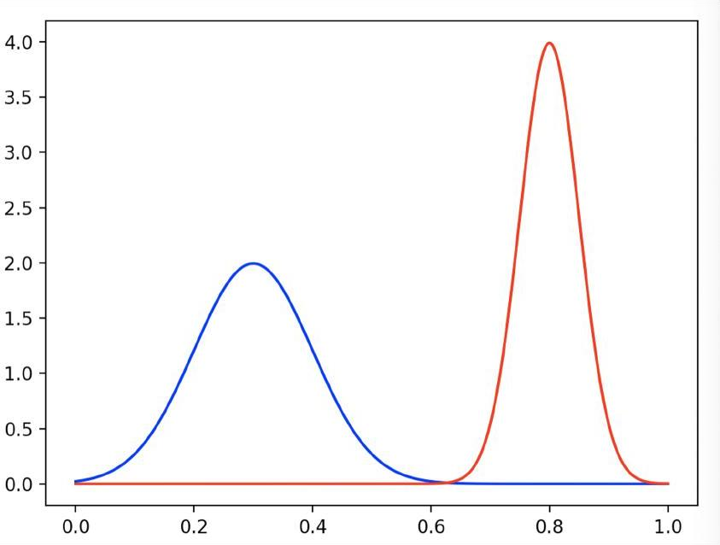
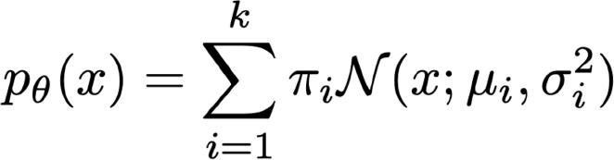
Example Density Model: Mixtures of Gaussians
Parameters: means and variances of
components, mixture weights

Slide 9



Flow Models: Invertible transform from data x to embedding z
Original data space, complex distribution
Embedding space, we enforce a simpler distribution
to model
x
...
Note: VAE has very similar diagram, but learns both directions rather than imposing invertibility (next topic)
14
BITS Pilani, Pilani Campus

Slide 10
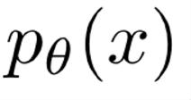

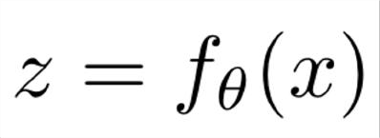



Flows: Main Idea
...
Generally:
Normalizing Flow:
How to train? How to evaluate
? How to sample?

Slide 11
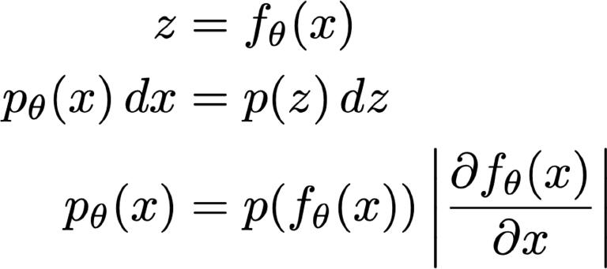

Change of Variables
fƟ(x)
dz
PƟ (x)
dx
Note: requires invertible & differentiable

Slide 12


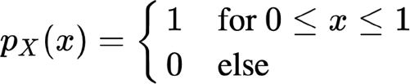


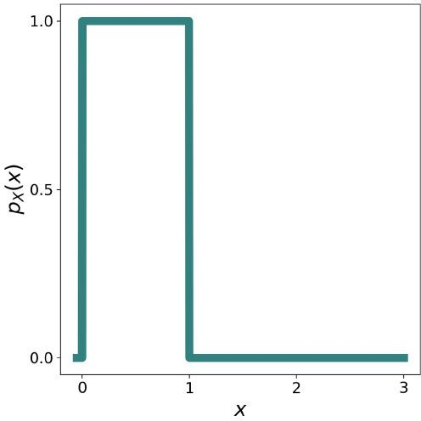
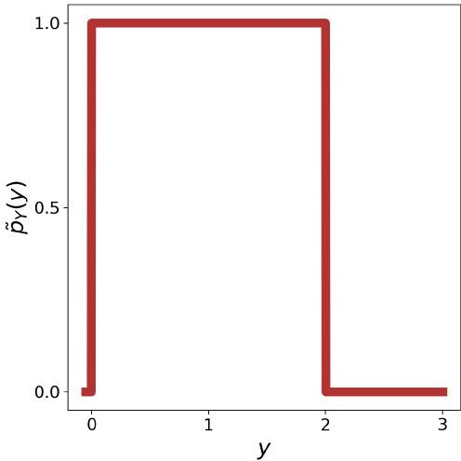
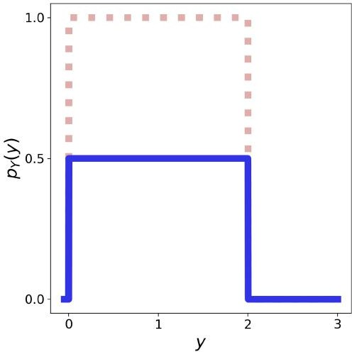
Change of Variable Density Needs to Be Normalized

Slide 13


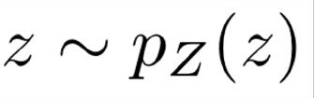
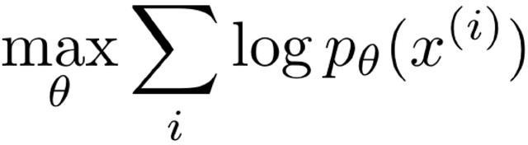
Flows: Training
...
2
BITS Pilani, Pilani₀Campus

Slide 14
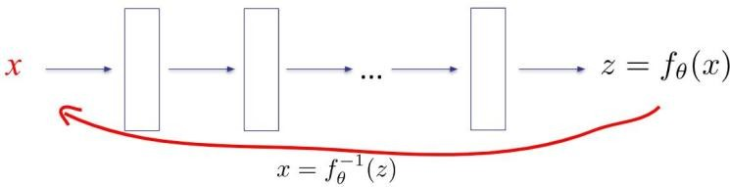
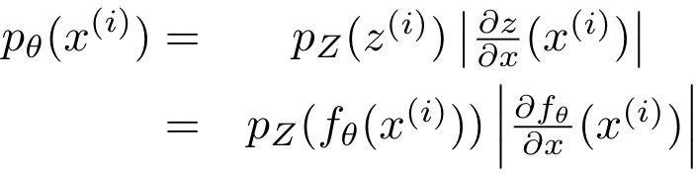
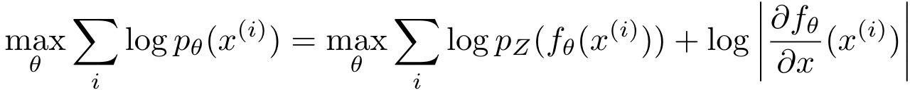

Flow Models: Training
Assuming we have an expression for
with Stochastic Gradient Descent
, this can be optimized
21
BITS Pilani, Pilani Campus

Slide 15
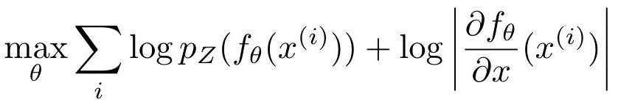




Flow Models: Examples
Two choices to make:
1.Invertible function class i.e.,
Embedding space density
Ideally an easy distribution to sample from, e.g.
“normalizing flow”
in 1-D this is any monotonic function, e.g.,
a x + b (for positive a)
polynomials with positive coefficients and only odd powers
exp (theta x)
sigmoid (a x + b)
mixture of Gaussians
-> make sure maps to [0,1]
cumulative density functions, e.g. CDF of mixture of
Gaussians or weighted sum of logistics
composition of flows
BITS Pilani, Pilani Campus

Slide 16
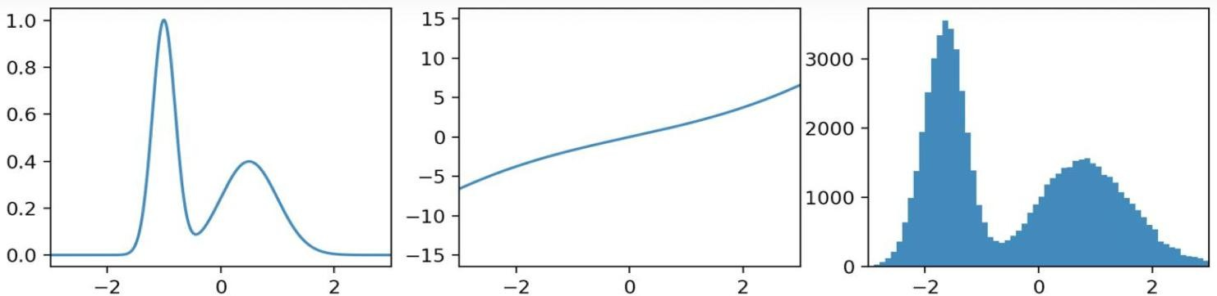
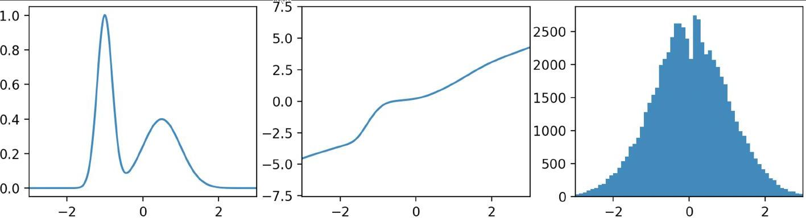
Example: Flow to Gaussian z
Before training
After training
True distribution of x
Flow x → z
Empirical distribution of z
24
BITS Pilani, Pilani Campus

Slide 17
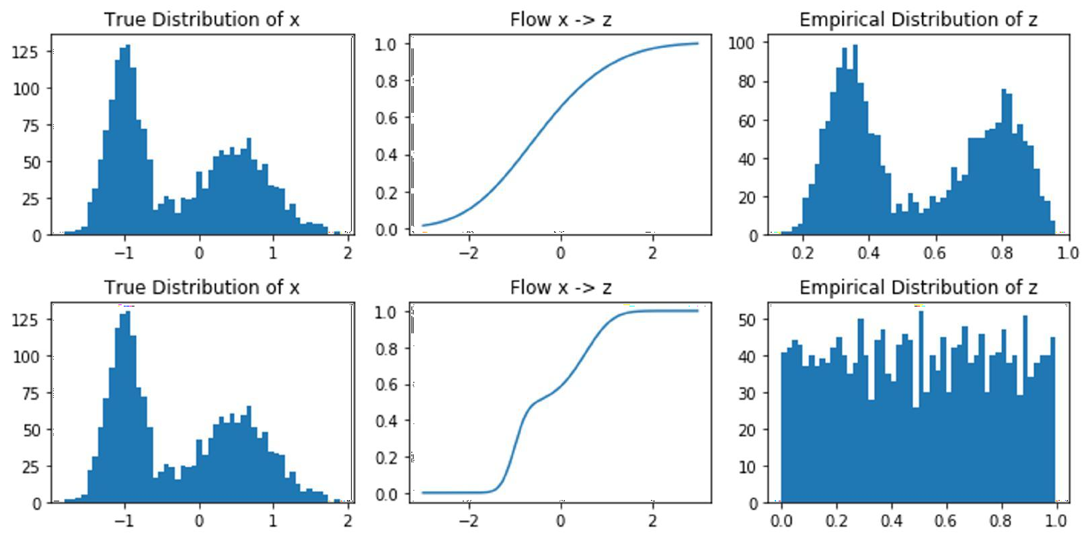
Example: Flow to Uniform z
Before training
After training
Tru e distribution of x
Flow x → z

Slide 18
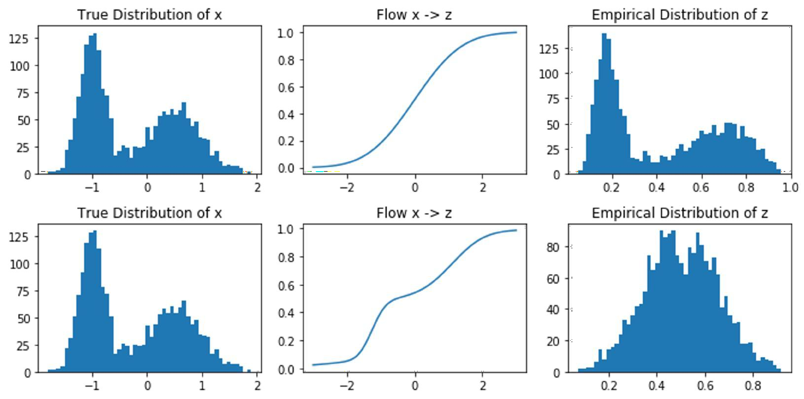
Example: Flow to Beta(5,5) z
Before training
After training
Tru e distribution of x
Flow x → z

Slide 19

What do we need to keep in mind for f?
...
Recall, change of variable formula requires
Invertible & differentiable

Slide 20

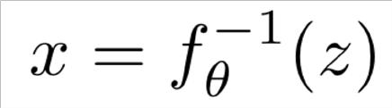
Flows: Sampling
...
Step 1: sample
Step 2:

Slide 21
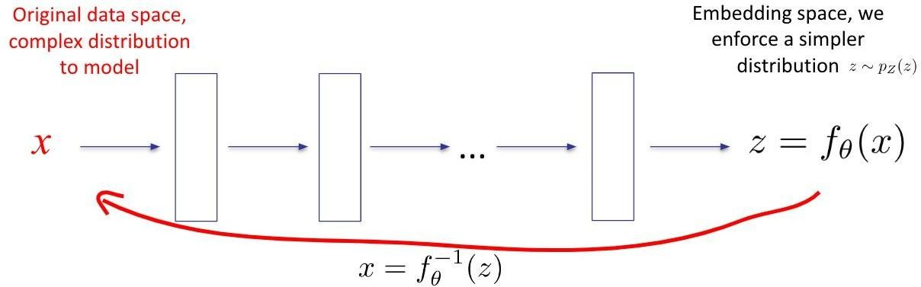
1-D Flow Models Summary
Training:
Inference: evaluate training objective
Sampling: first sample z from
then compute
29
BITS Pilani, Pilani Campus

Slide 22
Aside: special case of a CDF and p(z) = U[0,1]
e.g., Gaussian CDF, mixture CDF, logit CDF, multiple CDFs
30
BITS Pilani, Pilani Campus

Slide 23
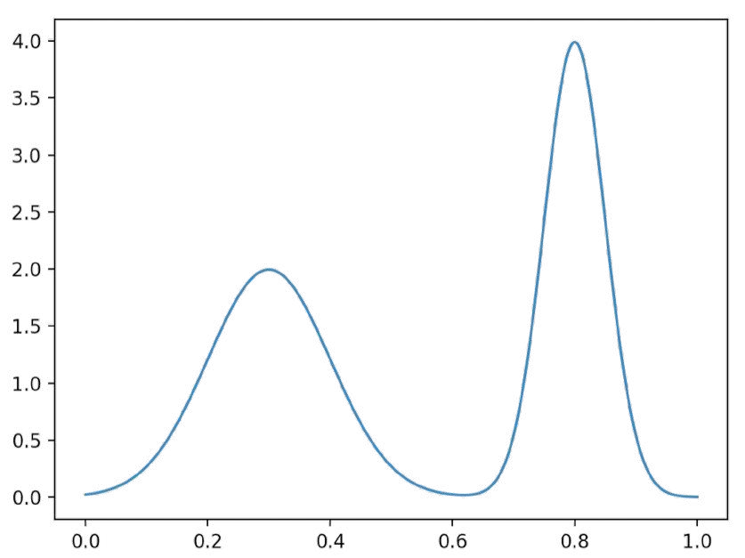
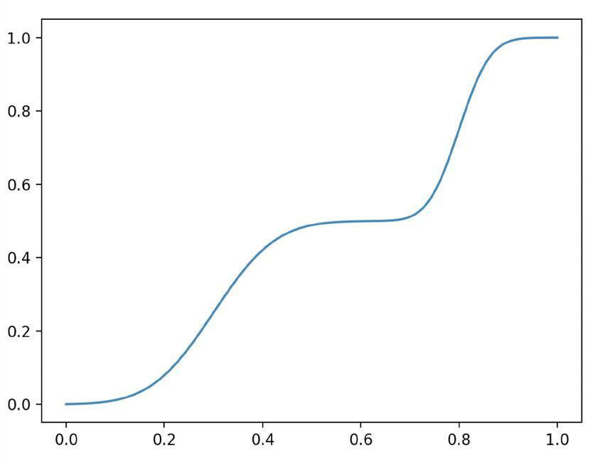
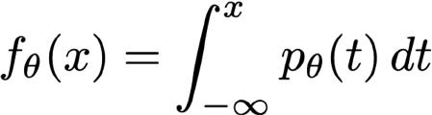

Refresher: Cumulative Density Function (CDF)

Slide 24
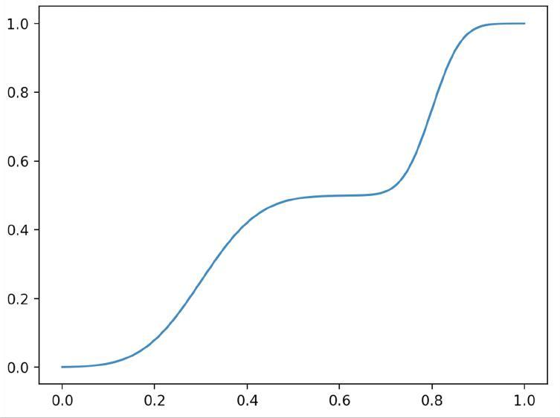
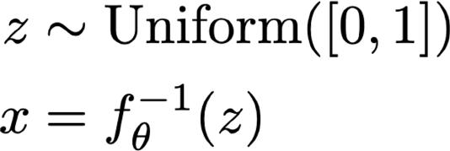
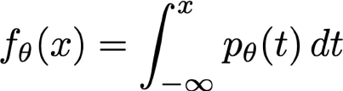
Sampling via inverse CDF
Sampling from the model:
The CDF is an invertible, differentiable map from data to [0, 1]

Slide 25
CDF Flows: special case of and p(z) = U[0,1]
a CDF
If we use a flow defined as a parameterized CDF, we recover the original objective for fitting the corresponding parameterized PDF.

Slide 26
CDF Flows: special case CDF and p(z) U[0,1]
of
a
If we use a flow defined as a parameterized CDF, we recover the original
objective for fitting the corresponding parameterized PDF.
this term constant per p(z) uniform
cdf’(x) = pdf(x)

Slide 27
Practical Parameterizations of Flows
Requirement: Invertible and Differentiable
Cumulative Density Functions
E.g. Gaussian mixture density, mixture of logistics
Neural Net
If each layer flow, then sequencing of layers = flow
Each layer:
ReLU?
Sigmoid?
Tanh?

Slide 28
How general are flows?
Can every (smooth) distribution be represented by a (normalizing) flow? [considering 1-D for now]

Slide 29







How general are flows?
CDF turns any density into uniform
Inverse flow is flow
→ can turn any (smooth) p(x) into any (smooth) p(z)

Slide 30
Outline
Foundations of Flows (1-D)
2-D Flows
N-D Flows
Dequantization
38
BITS Pilani, Pilani Campus

Slide 31


2-D Autoregressive Flow
Note that the dependence on x1 in f_theta2 can be arbitrarily complex (including any neural net), no invertibility requirements
Why?
x1 is also given when inverting from z2 to x2

Slide 32
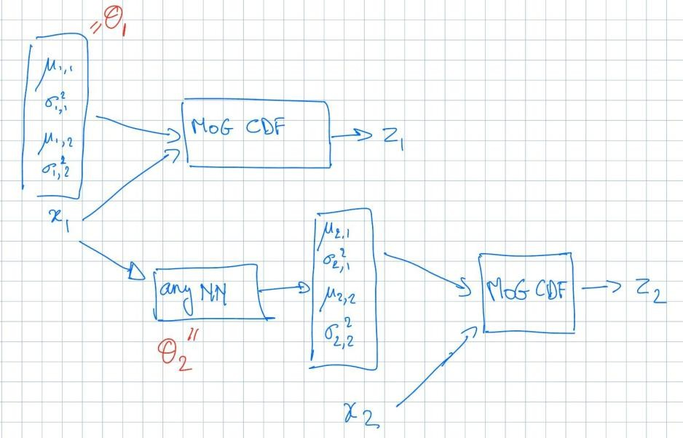
Example 2-D Autoregressive Flow

Slide 33
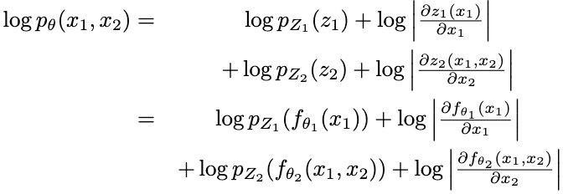
Training Objective

Slide 34
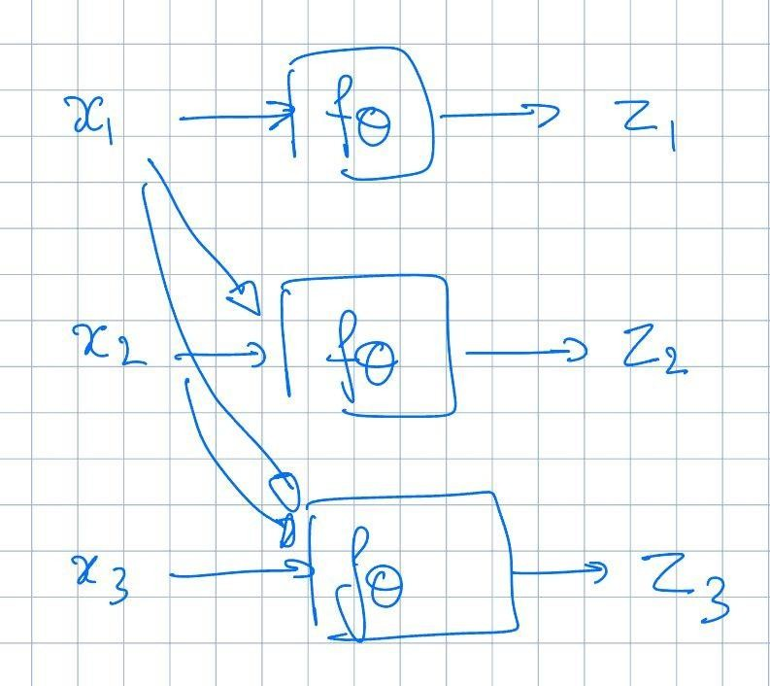
Autoregressive flows

Slide 35
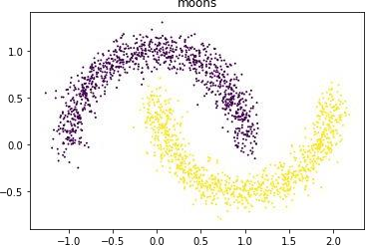
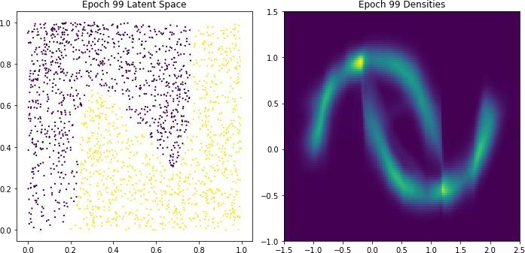
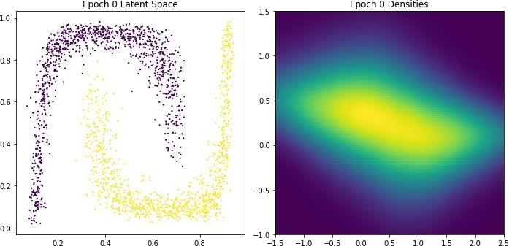
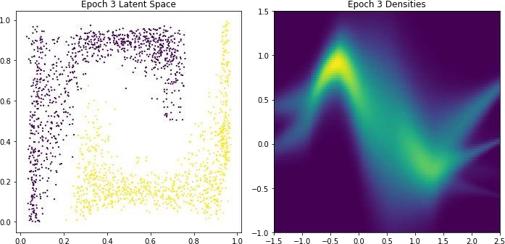
2-D Autoregressive Flow: Two Moons
Architecture:
Base distribution: Uniform[0,1]^2
x1: mixture of 5 Gaussians
i.e. z1 = cdf of Mo5G
x2: mixture of 5 Gaussians, conditioned on x1
I.e. z2 = cdf of Mo5G with mixture weights w, means mu, variances sigma conditioned on x1. I.e. arbitrary NN can be trained to map from x1 to w, mu, sigma

Slide 36
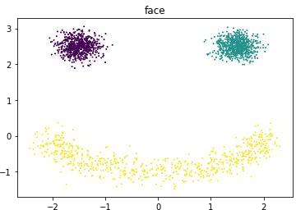
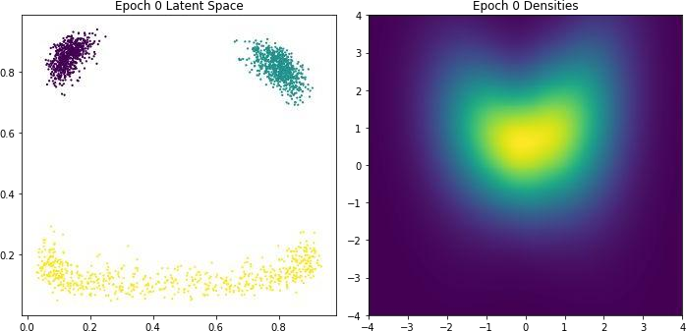
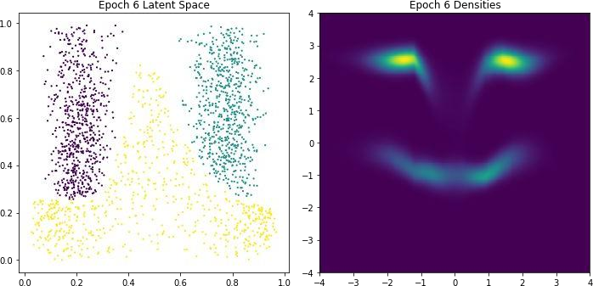
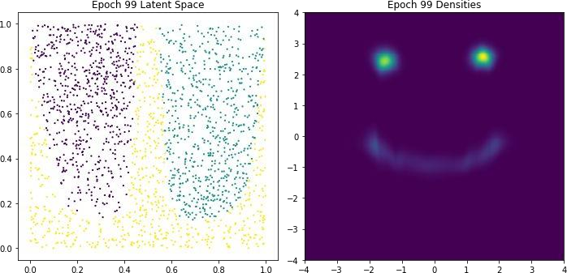
2-D Autoregressive Flow: Face
Architecture:
Base distribution: Uniform[0,1]^2
x1: mixture of 5 Gaussians
x2: mixture of 5 Gaussians, conditioned on x1
44
BITS Pilani, Pilani Campus

Slide 37
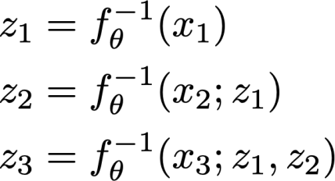
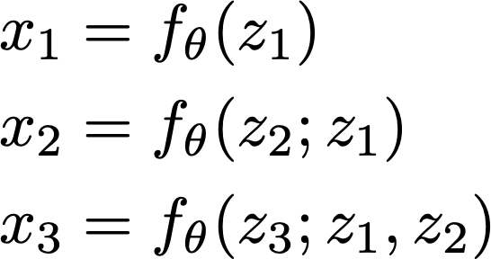
Inverse autoregressive flows
The inverse of an autoregressive flow is also a flow, called the inverse autoregressive flow (IAF)
x → z has the same structure as the sampling in an autoregressive model
z → x has the same structure as log likelihood computation of an autoregressive model. So, IAF sampling is fast

Slide 38
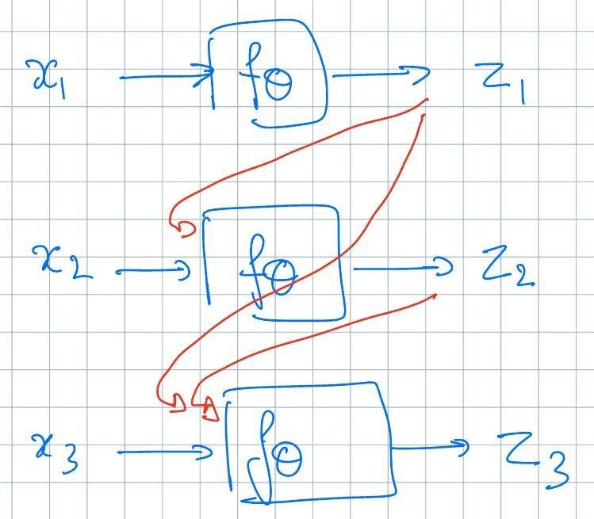
AF
IAF
Training: parallel / fast
Sampling: long serial chain
Training: long serial chain
Sampling: parallel / fast

Slide 39
AF vs IAF
Autoregressive flow
Fast evaluation of p(x) for arbitrary x
Slow sampling
Inverse autoregressive flow
Slow evaluation of p(x) for arbitrary x, so training directly by
maximum likelihood is slow.
Fast sampling
Fast evaluation of p(x) if x is a sample
There are models (Parallel WaveNet, IAF-VAE) that exploit
IAF’s fast sampling
47
BITS Pilani, Pilani Campus

